Slide 1
The types of plate boundaries

Slide 2
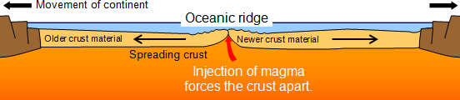
Constructive Margin
How is it formed?
Convection currents cause the plates to move apart
As the plates move apart the magma wells up from the mantle to form new basaltic oceanic crust (new plate area is formed)
The Earth’s surface area increases due to the formation of new oceanic crust – sea floor spreading

Slide 3
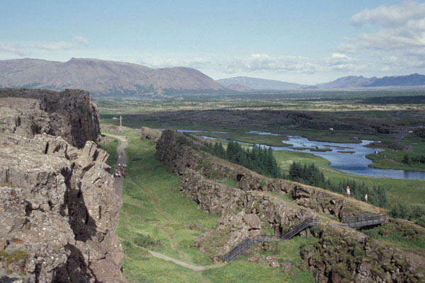
Mid-Atlantic Ridge
The Mid-Atlantic Ridge passing through Iceland

Slide 4
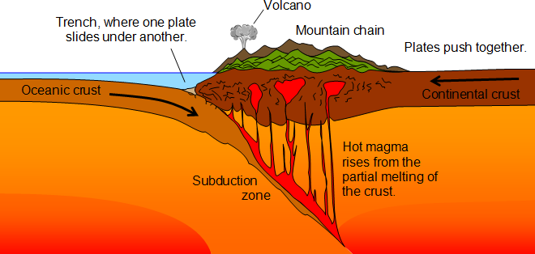
Destructive Margin
The thicker, denser oceanic plate slides beneath the continental plate (subduction)
The oceanic plate melts as it reaches the hot mantle
Folding of the continental plate forms mountains
As the plates slide past each other, friction stores energy in rocks – energy is released in earthquakes

Slide 5
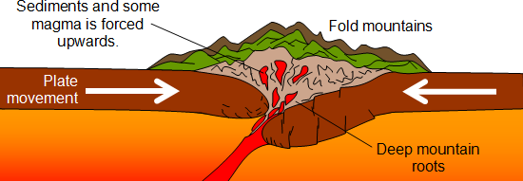
Collision plate margins

Slide 6
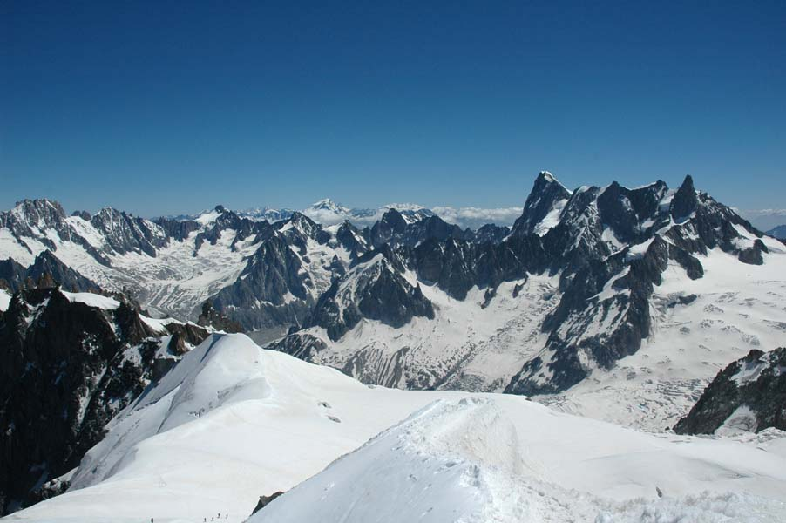
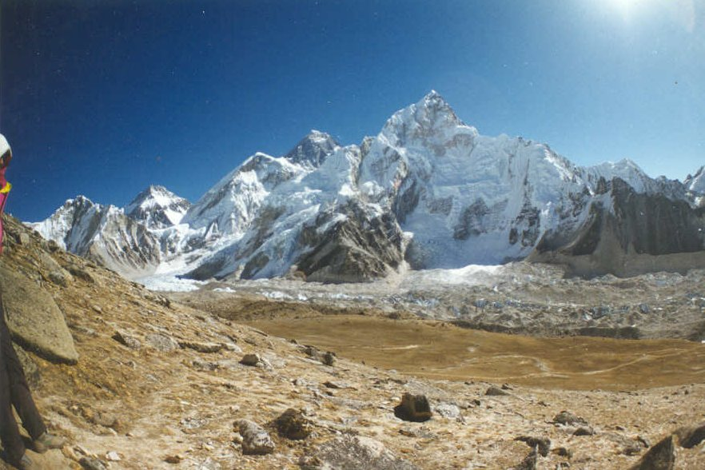
The Alps and the Himalayas
The Alps
The Himalayas

Slide 7
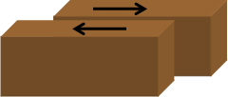
Conservative Margins
As the plates slide horizontally past each other pressure builds up in the rocks either side of the fault
Fault surface often rough – friction creates large strains along the faults
An earthquake happens when the built up pressure and energy are released in a sudden, jerky movement

